Slide 1
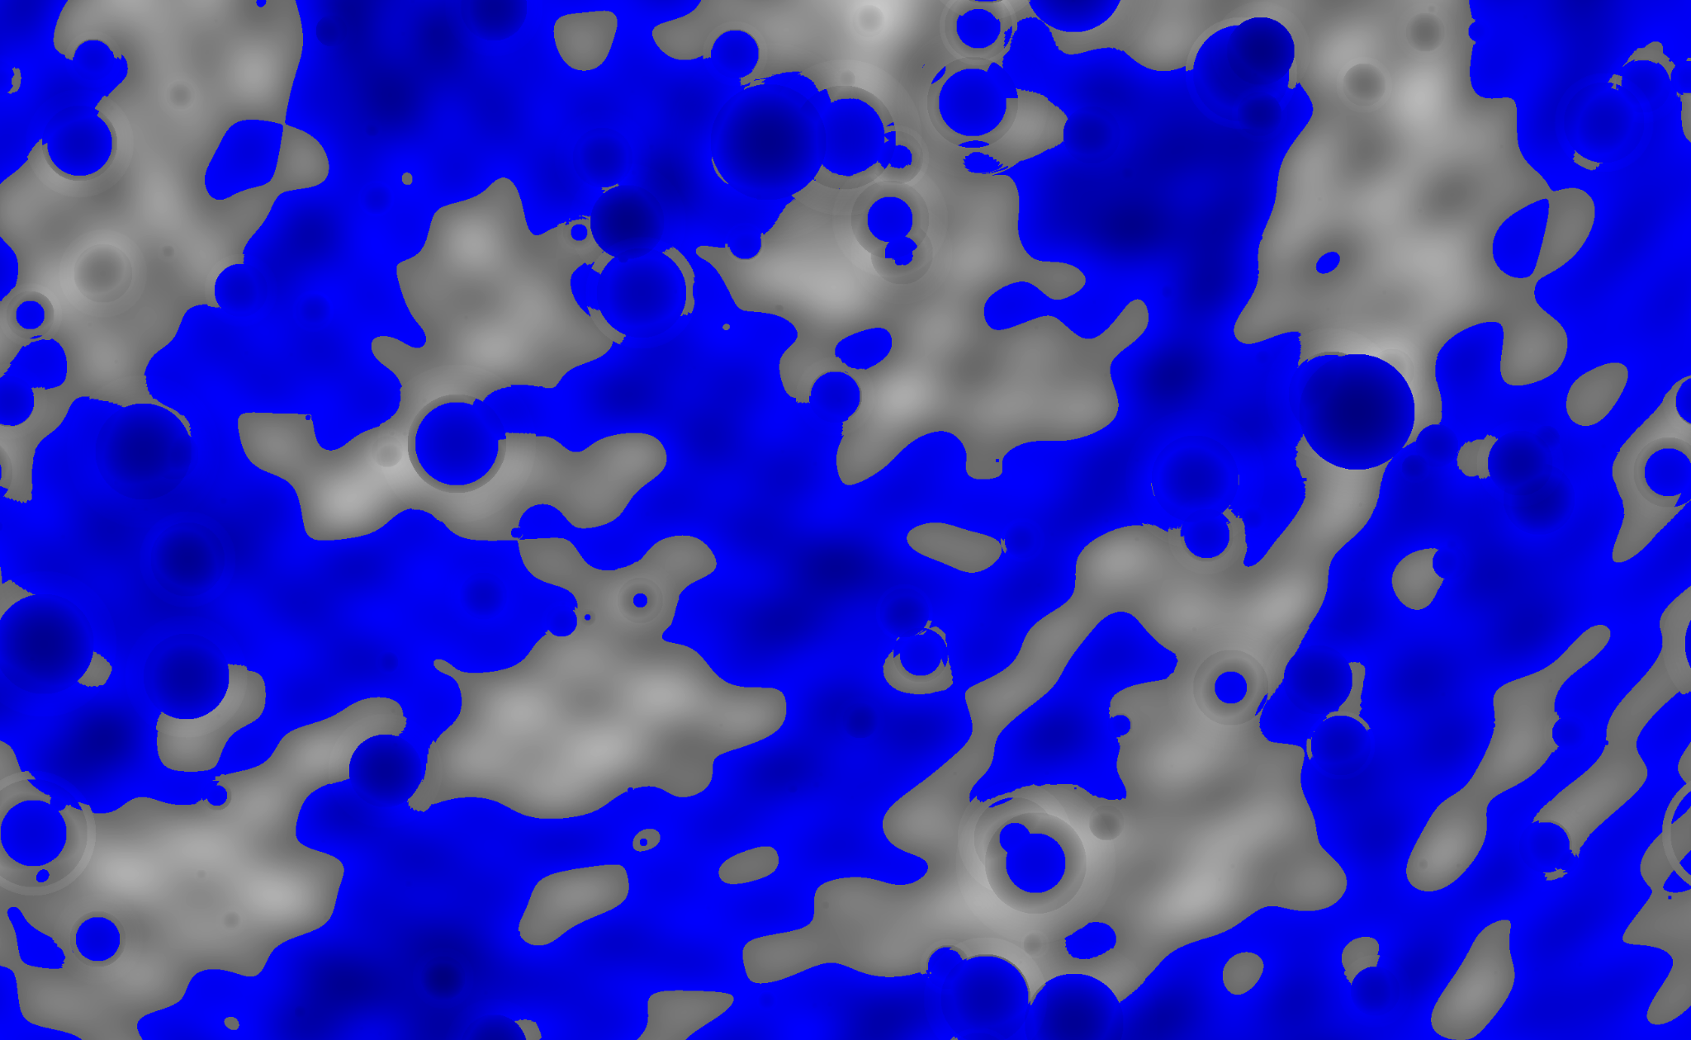
Mimic
A Pseudo-realistic procedural map generator built in Rust
12/11/24
Sage A.
1

Slide 2
Chapters
Mimic - Procedural Map Generator
1.
Introduction
2.
Analysis and Design
3.
Rust
4.
Implementation
5.
Reflections

Slide 3

Concept
Introduction
Mimic - Procedural Map Generator
Procedural map generation often relies almost exclusively on some combination of noise generation to create maps
Minimize that by designing and using generation algorithms based off real-world processes
Create maps of on truly global scales

Slide 4
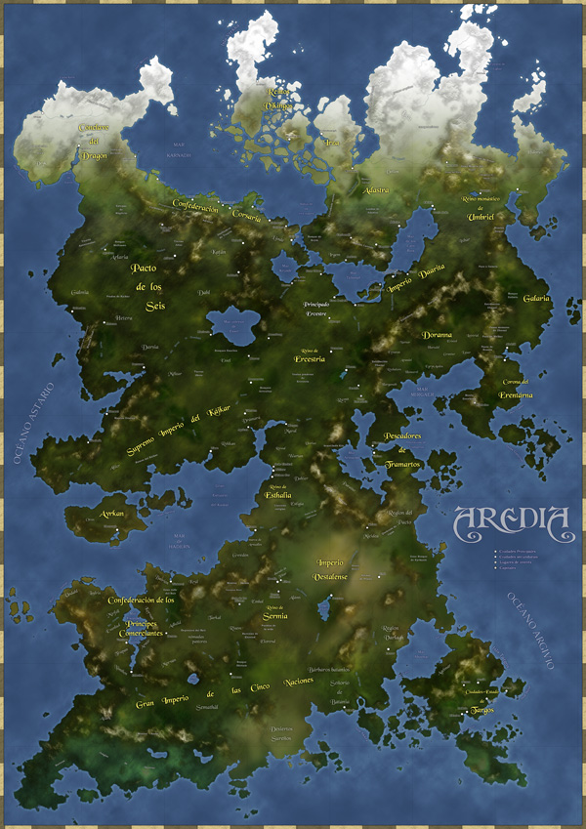
Application
Introduction
Mimic - Procedural Map Generator
Reference for what to make the terrain look like at a specific location in a game
Create detailed and unique worlds on the fly for TTRPGs
Quickly create a world to be used as a starting point for storytelling or game design
https://en.wikipedia.org/wiki/Worldbuilding#/media/File:ArediaWikipedia.jpg

Slide 5
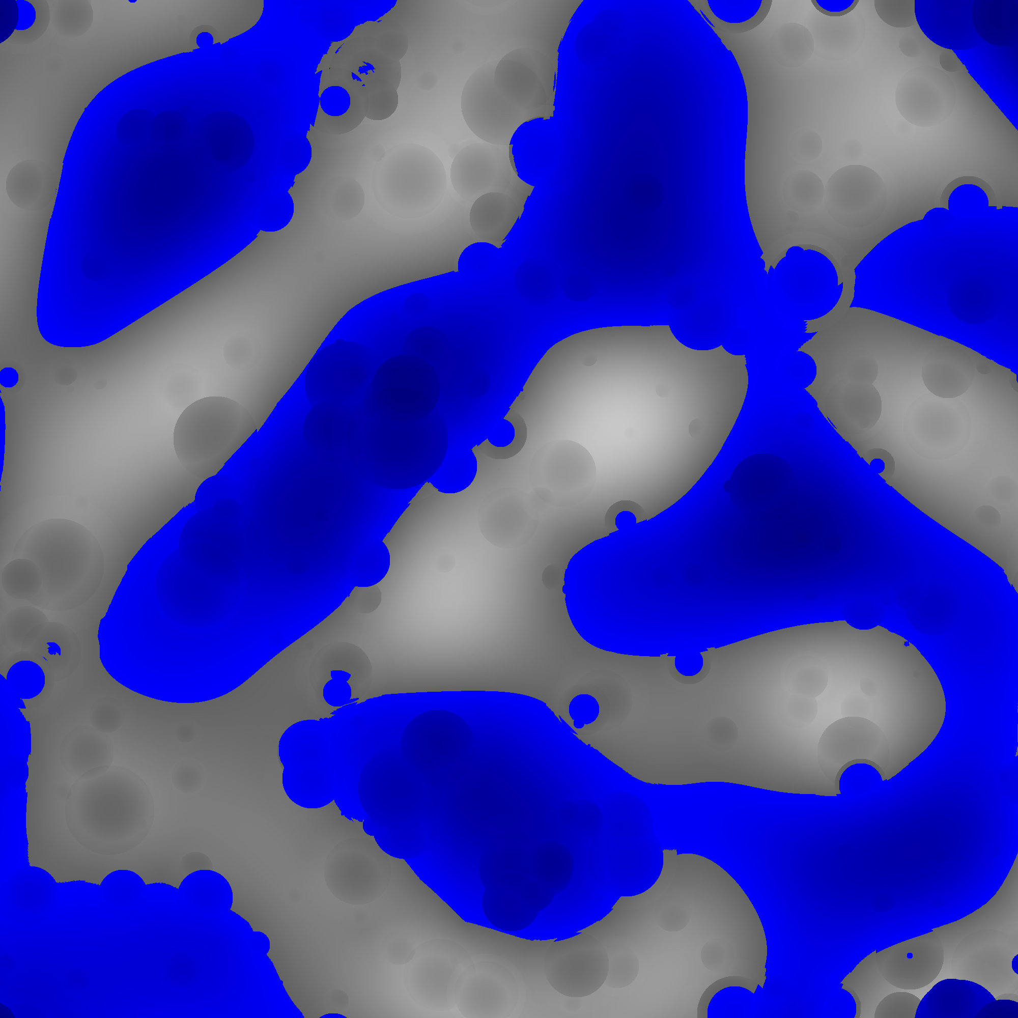
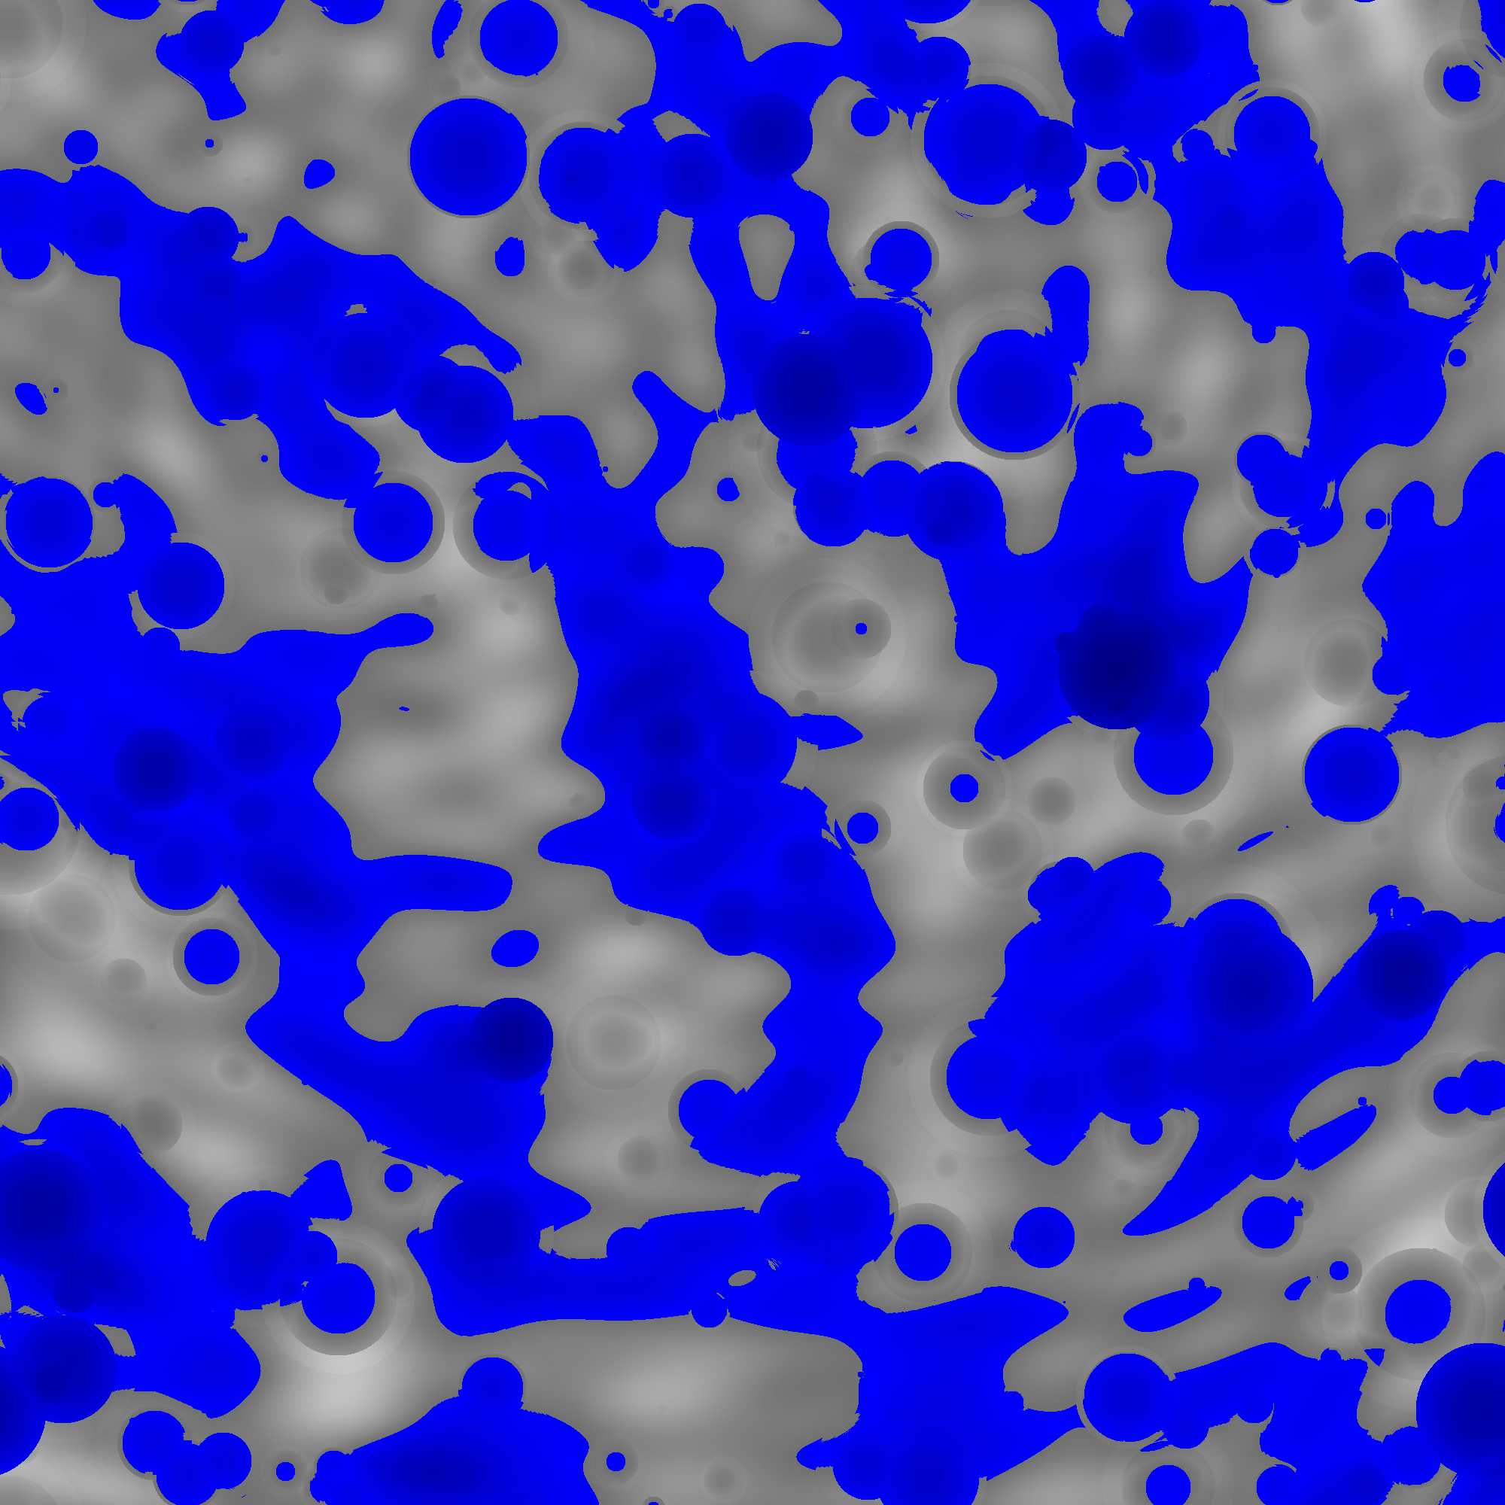
Analysis and Design
Mimic - Procedural Map Generator
Results

Slide 6
Chapters
Mimic - Procedural Map Generator
1.
Introduction
2.
Analysis and Design
3.
Rust
4.
Implementation
5.
Reflections

Slide 7
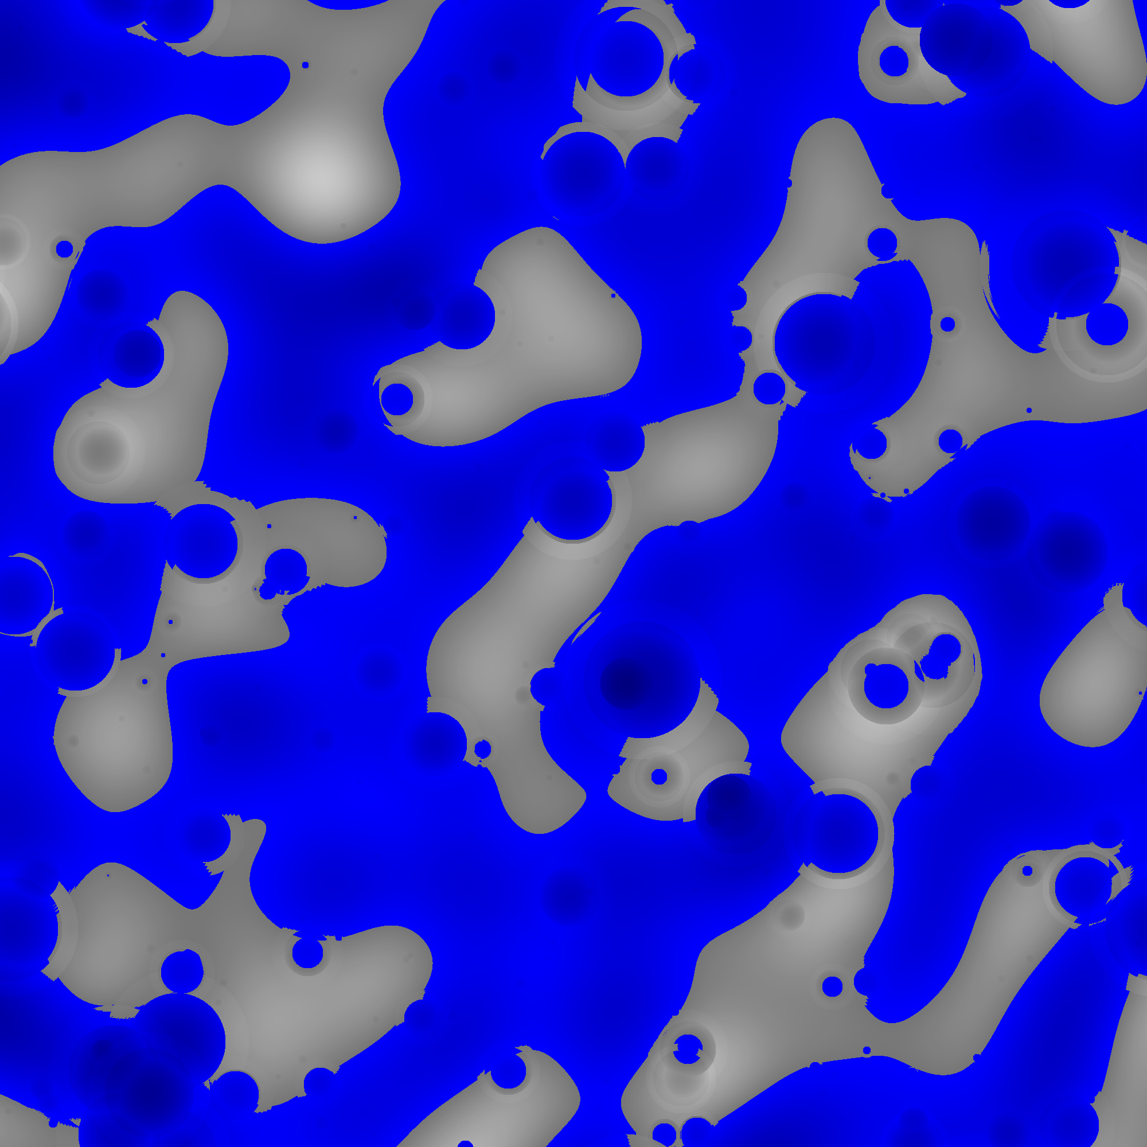
Map Info
Analysis and Design
Mimic - Procedural Map Generator
Should be high enough resolution to see all significant terrain features visible at global scale
1 tile = 5km x 5km and holds onto an amount of height
One unit of height = 100 meters
Can be, at least, 2000 x 2000 tiles, placing them at around a fifth the surface area of the Earth

Slide 8
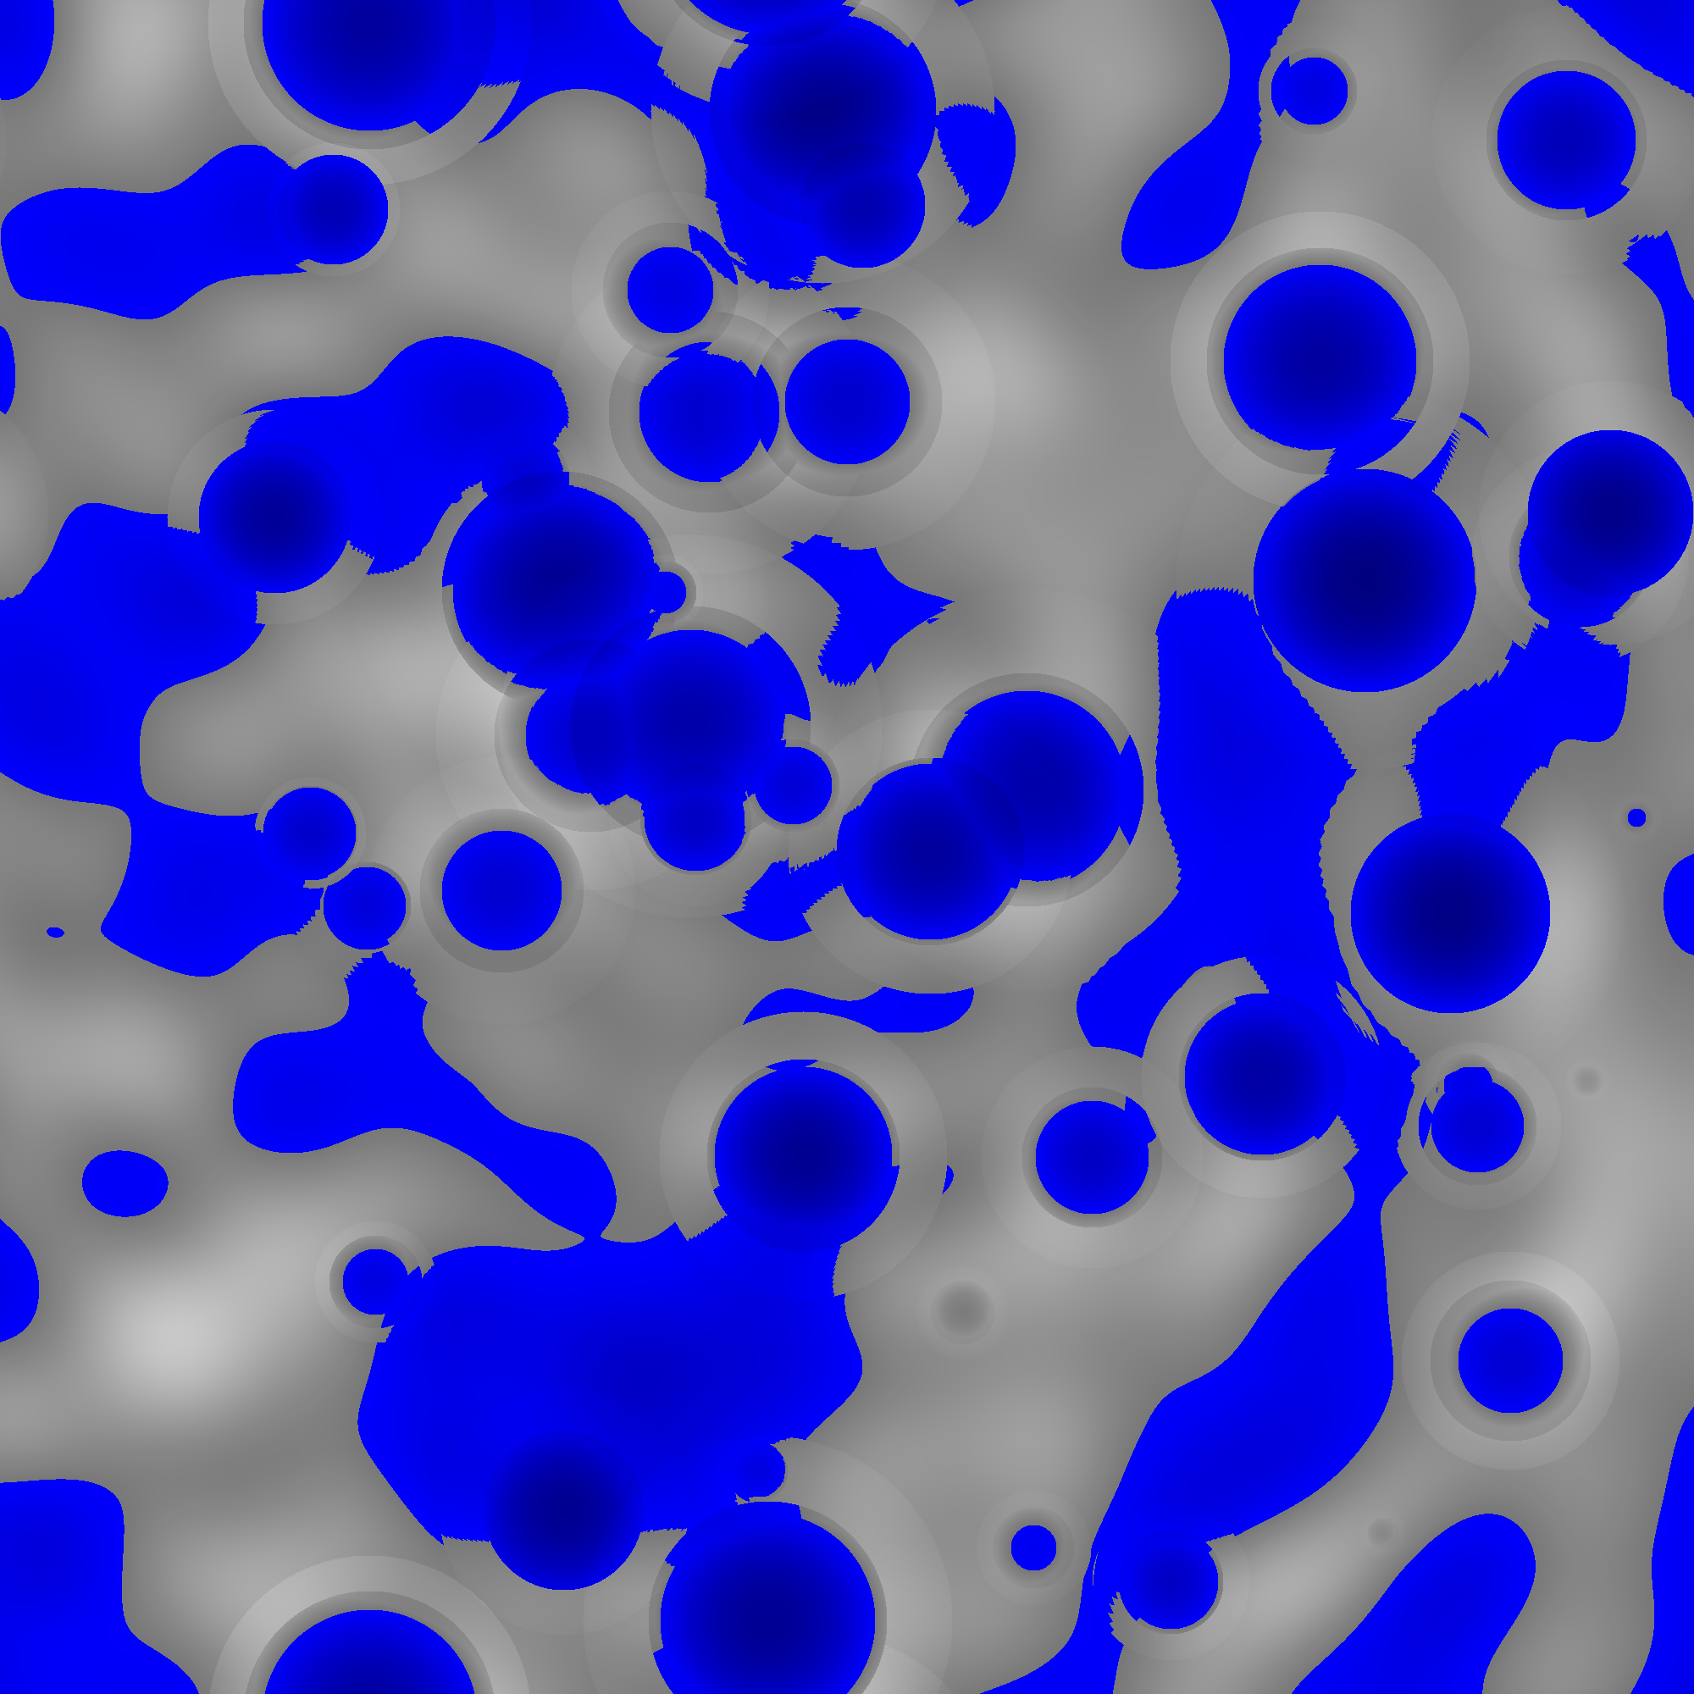
Design
Analysis and Design
Mimic - Procedural Map Generator
Parameterize input for ability to take specifications that can customize map generation behavior
Interpret a generated map’s data into information usable by an image generator
Generate and save an image of generated maps
Modularity

Slide 9
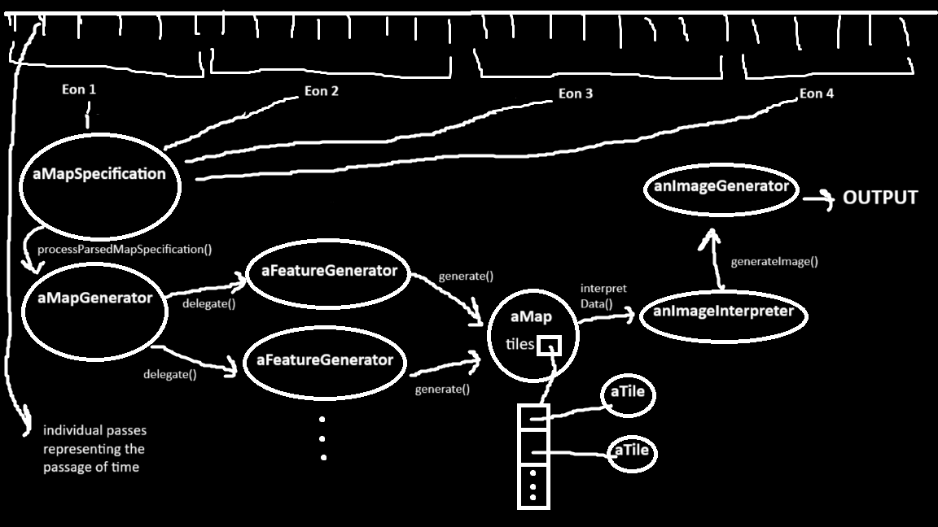
Analysis and Design
Mimic - Procedural Map Generator

Slide 10
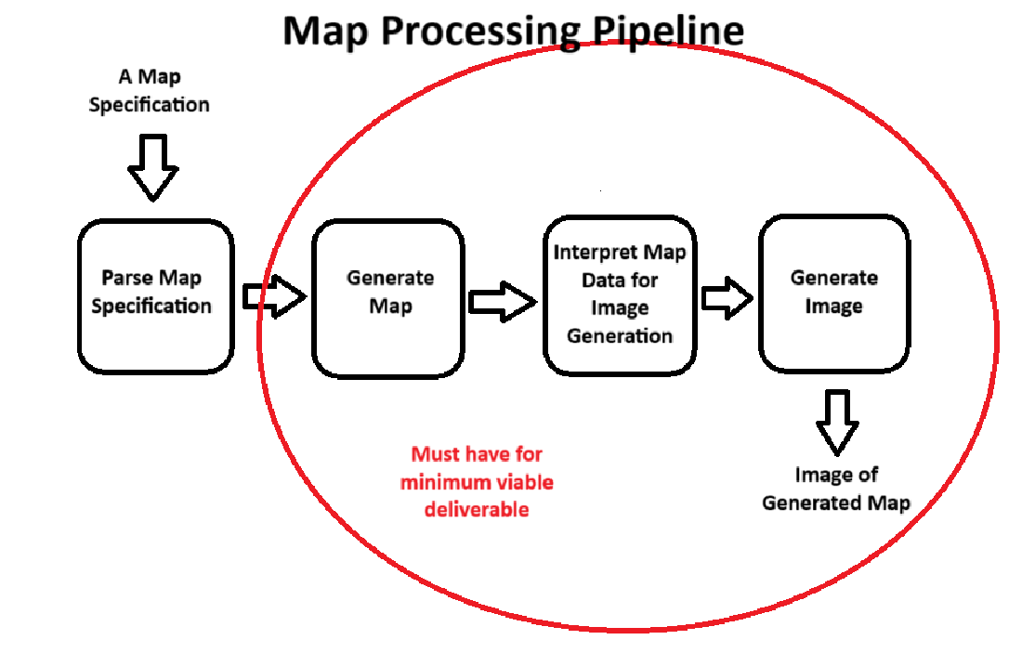
Analysis and Design
Mimic - Procedural Map Generator

Slide 11
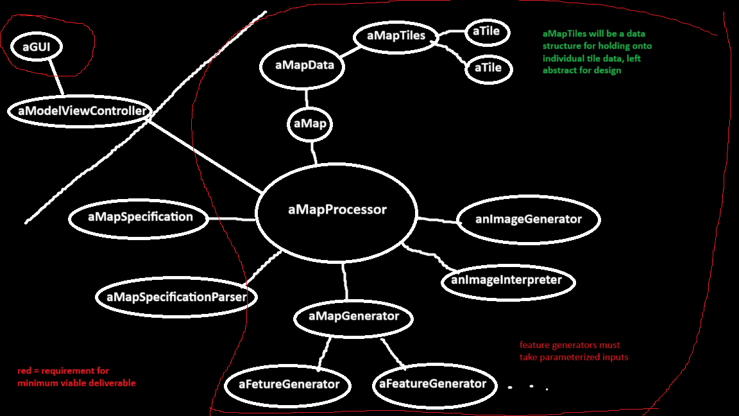
Analysis and Design
Mimic - Procedural Map Generator

Slide 12
Agile
Analysis and Design
Mimic - Procedural Map Generator
Research
New Requirement Found
Large project scale
New language with different system for managing memory
Time constraints
The ability to scale back project scope if necessary was non-optional
Adopting an Agile development mentality made the most sense for this purpose
Design
Research
Code
Design
Test
Code
Release
Test

Slide 13
Analysis and Design
Mimic - Procedural Map Generator
Development Priority Tiers
Minimum Viable Deliverable
2000 x 2000 tile map
At least two feature generators with parameterized inputs
Map data interpretation for image generation
Image generation and saving
Basic GUI
Ideal Deliverable
Map specification design
Map specification parsing
Simulation of multiple unique eons
More interpretive feature generators
Modularity
Stretch Goals
Geographical Information System (GIS)
Refined GUI with more functionality
More feature generators
Map generation animation
And more…

Slide 14
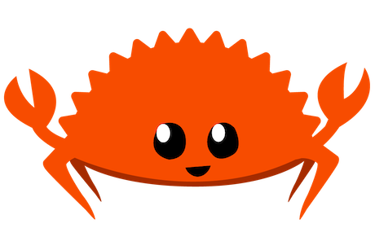
Chapters
Mimic - Procedural Map Generator
1.
Introduction
2.
Analysis and Design
3.
Rust
4.
Implementation
5.
Reflections

Slide 15
Overview
Rust
Mimic - Procedural Map Generator
Statically typed low level programming language
Began as a personal project, by Graydon Hoare in 2006
Designed to fix the memory management and allocation issues of C++

Slide 16
Rust
Mimic - Procedural Map Generator
Memory Management
Ownership and Borrowing

Slide 17
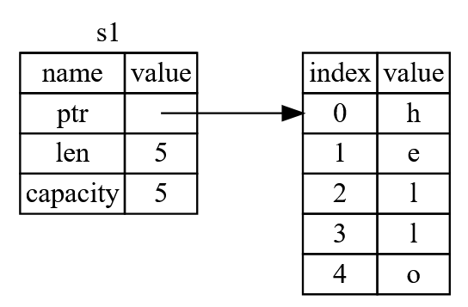
Ownership
Rust - Memory Management
Mimic - Procedural Map Generator
Every value in has an owner
Any value can only have one owner at a time
A value is dropped if its owner leaves any scope

Slide 18
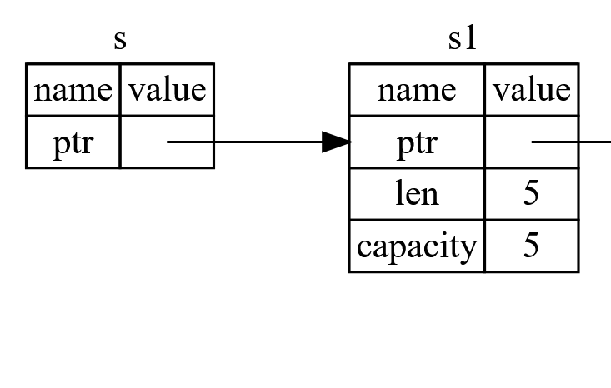
Borrowing
Rust - Memory Management
Mimic - Procedural Map Generator
A reference must always be to a valid value
At any given time, you can have either:
Any number of immutable references
One mutable reference

Slide 19
Rust
Mimic - Procedural Map Generator
Object Oriented Programming in Rust

Slide 20
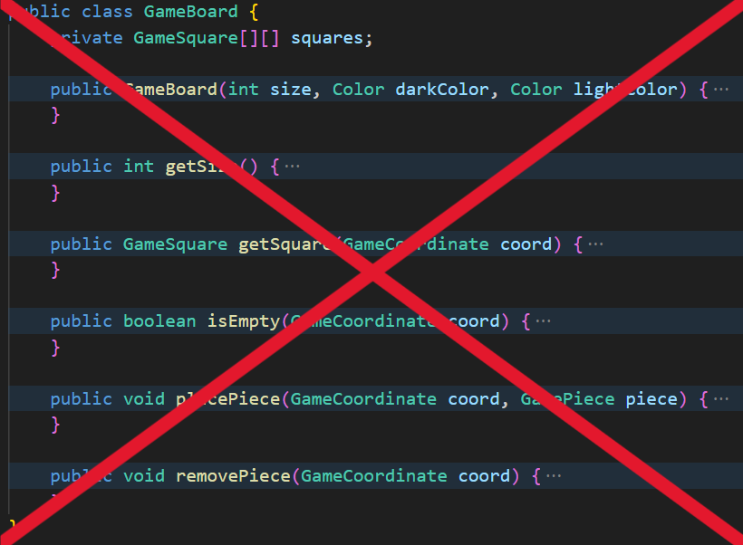
Abstraction and Encapsulation
Rust - OOP
Mimic - Procedural Map Generator
Rust doesn’t have classes
“Classes” in Rust = a struct + an implementation block
Methods vs Functions
Methods can be thought of as functions defined in the context of a struct
A method’s first parameter is always self

Slide 21
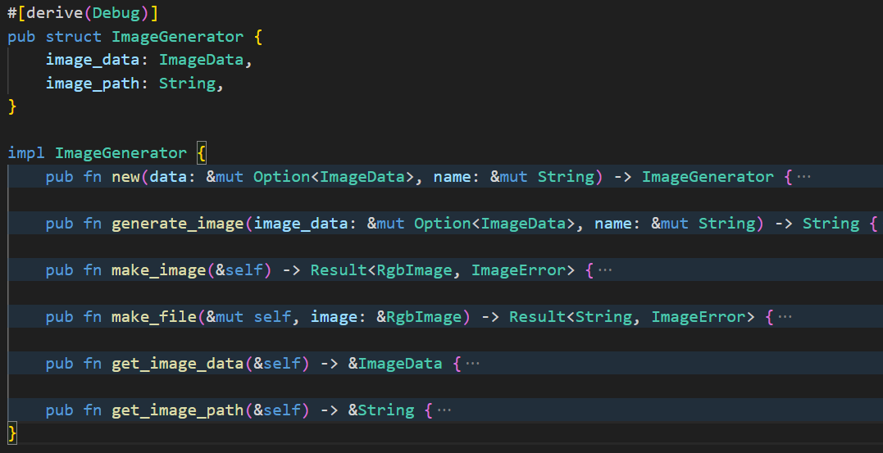
Rust - OOP
Mimic - Procedural Map Generator

Slide 22
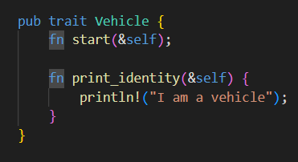
Traits
Rust - OOP
Mimic - Procedural Map Generator
Inheritance doesn’t exist in Rust, and instead uses trait objects
Traits define behaviors shared by their objects implementing them
Rust uses generics and traits to achieve bounded parametric polymorphism

Slide 23
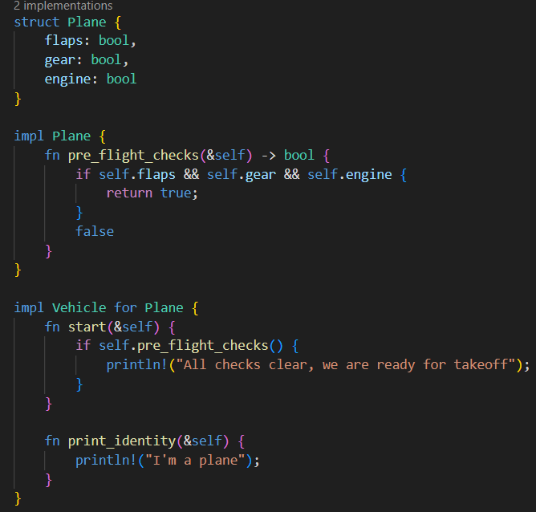
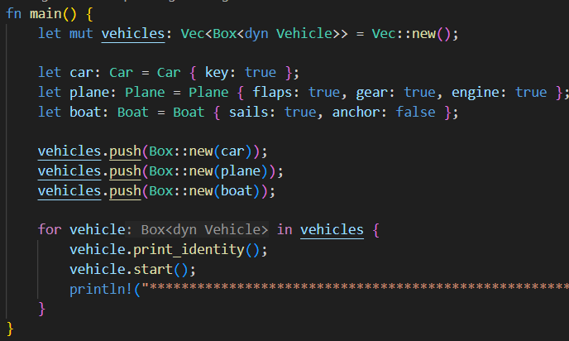
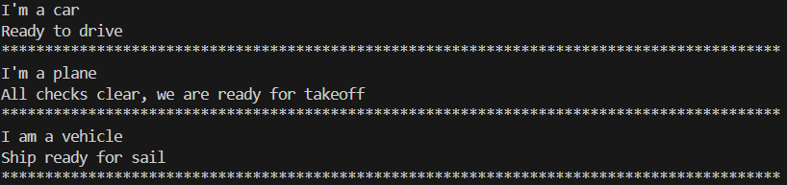
Rust - OOP
Mimic - Procedural Map Generator

Slide 24
Chapters
Mimic - Procedural Map Generator
1.
Introduction
2.
Analysis and Design
3.
Rust
4.
Implementation
5.
Reflections

Slide 25
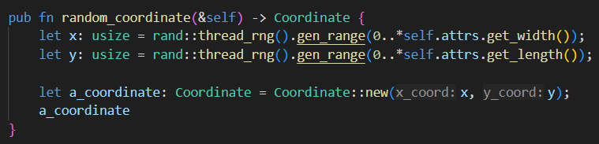
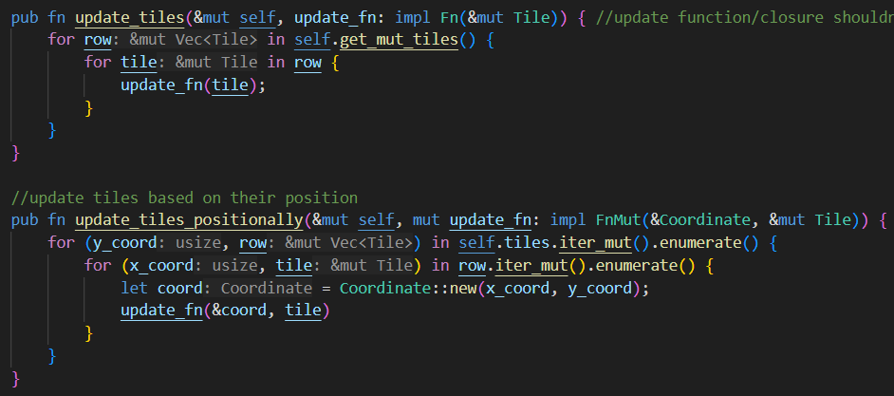
The Pipeline
Implementation
Mimic - Procedural Map Generator
MapProcessor holds onto everything, delegating to tasks to each phase of the pipeline’s respective object
MapGenerator implements another compose and delegate pattern, passing necessary info to each feature generators’ respective delegates
ImageGenerator uses interpreted image data and the image crate to create map image and save it to a file

Slide 26
Implementation
Mimic - Procedural Map Generator
Feature Generators

Slide 27
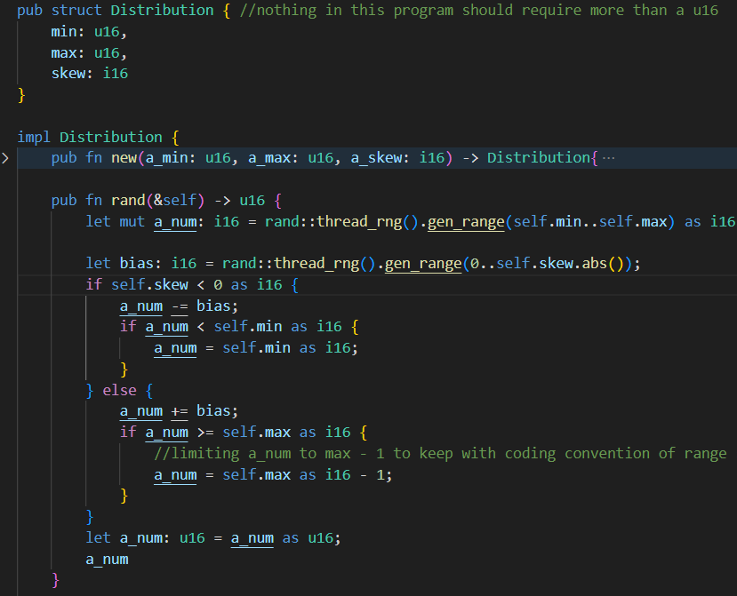
Impact Generator
Implementation - Feature Generators
Mimic - Procedural Map Generator
Takes in a number of impacts to generate, and a size distribution range
For each crater
Chooses random coordinate
Generates a random crater depth
Calculates that crater’s transient and rim radii
Generates crater

Slide 28
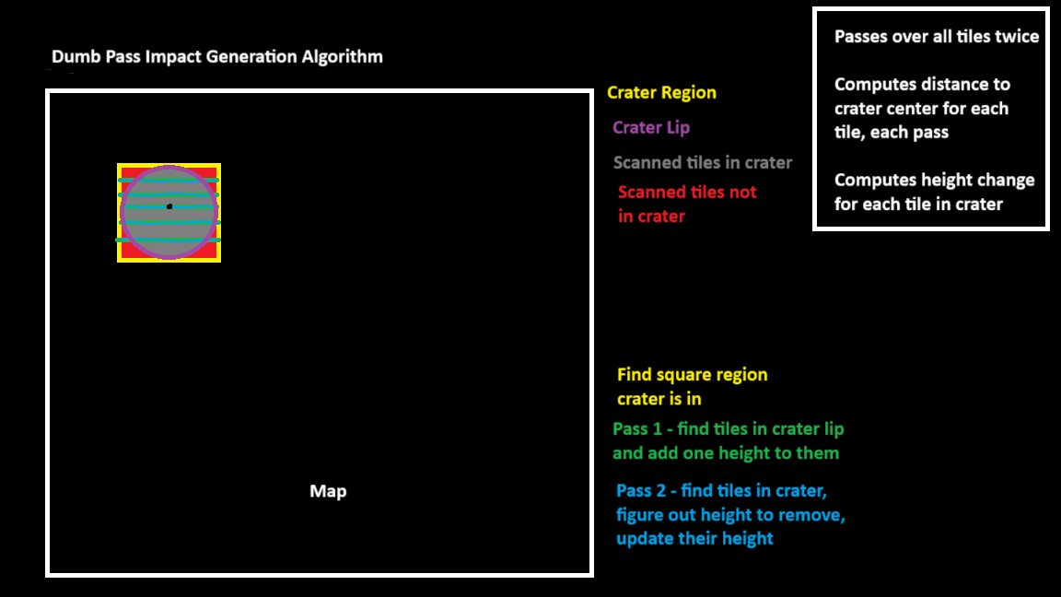
Implementation - Feature Generators
Mimic - Procedural Map Generator

Slide 29
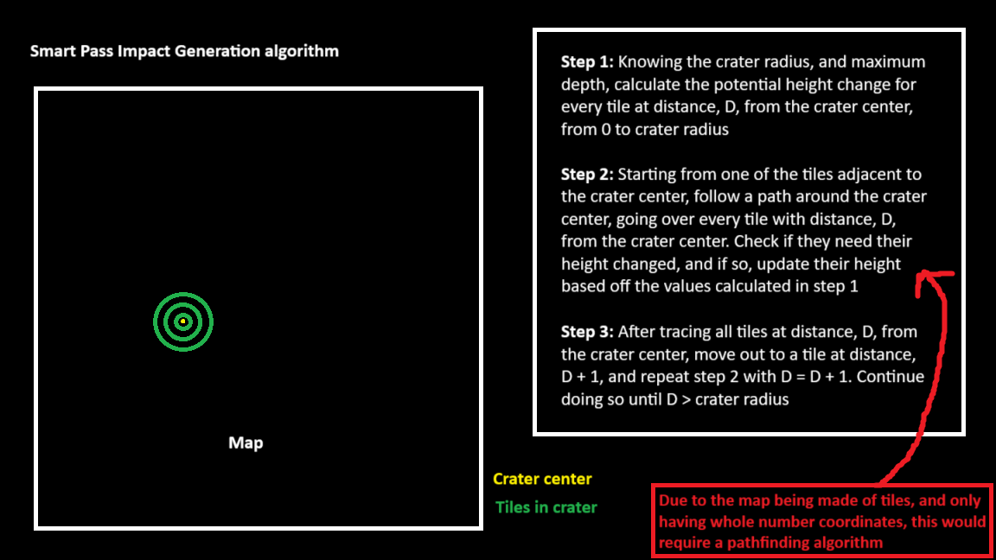
Implementation - feature Generators
Mimic - Procedural Map Generator

Slide 30
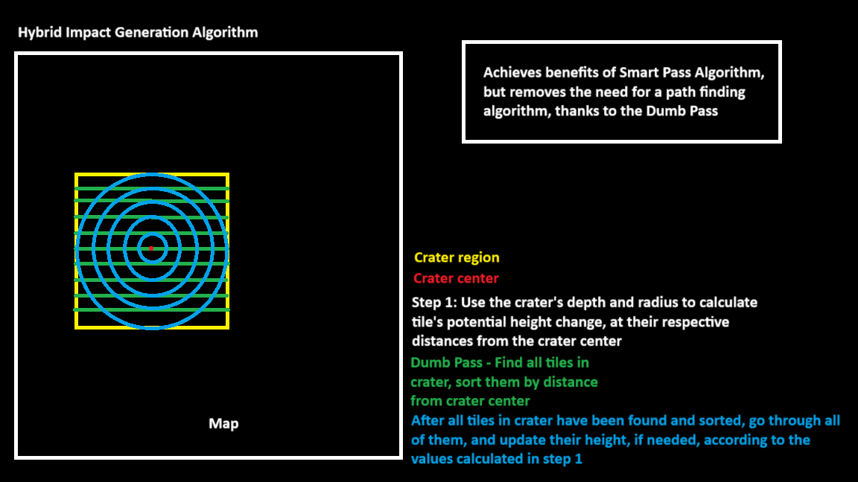
Implementation - Feature Generators
Mimic - Procedural Map Generator

Slide 31
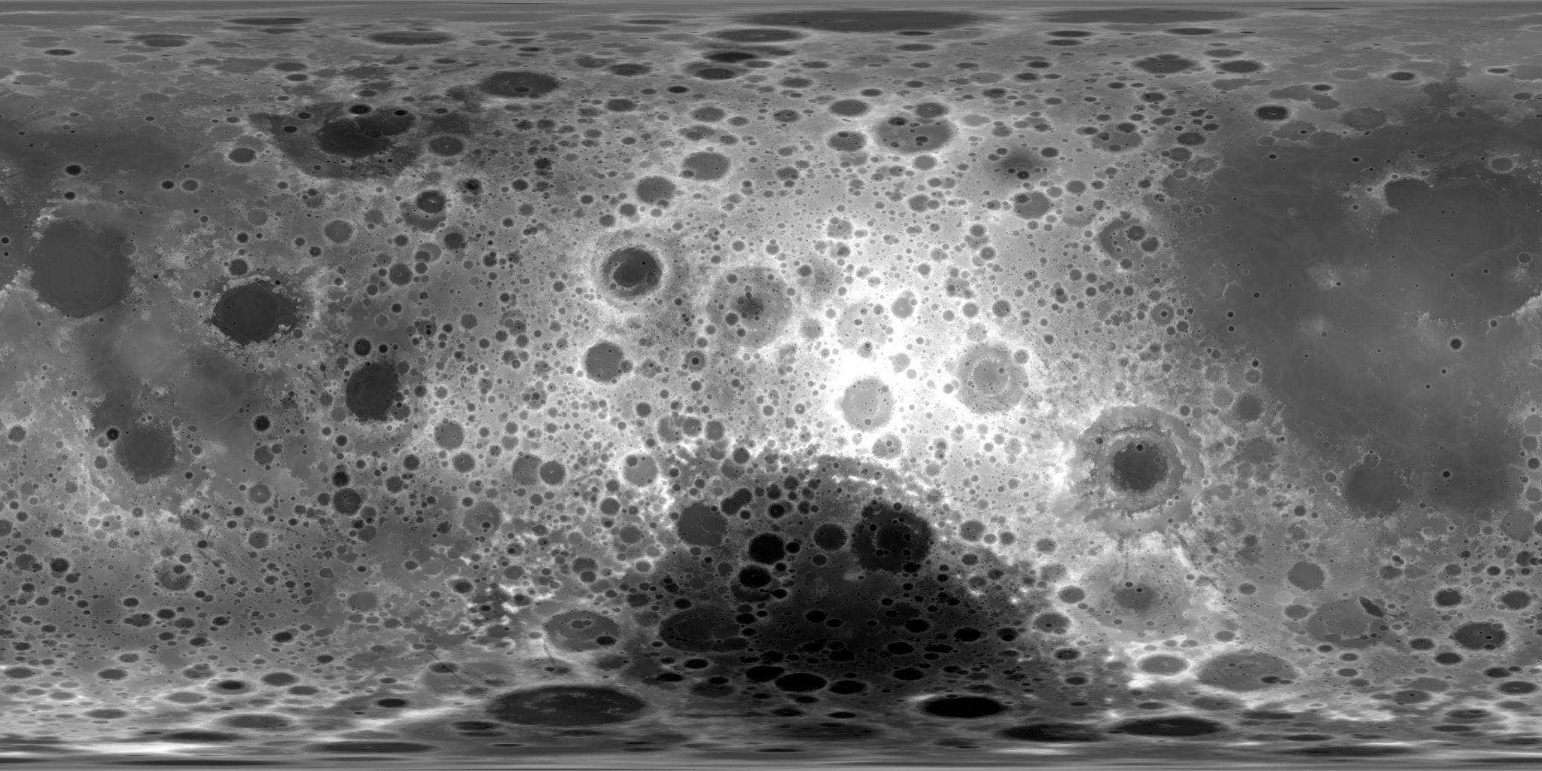
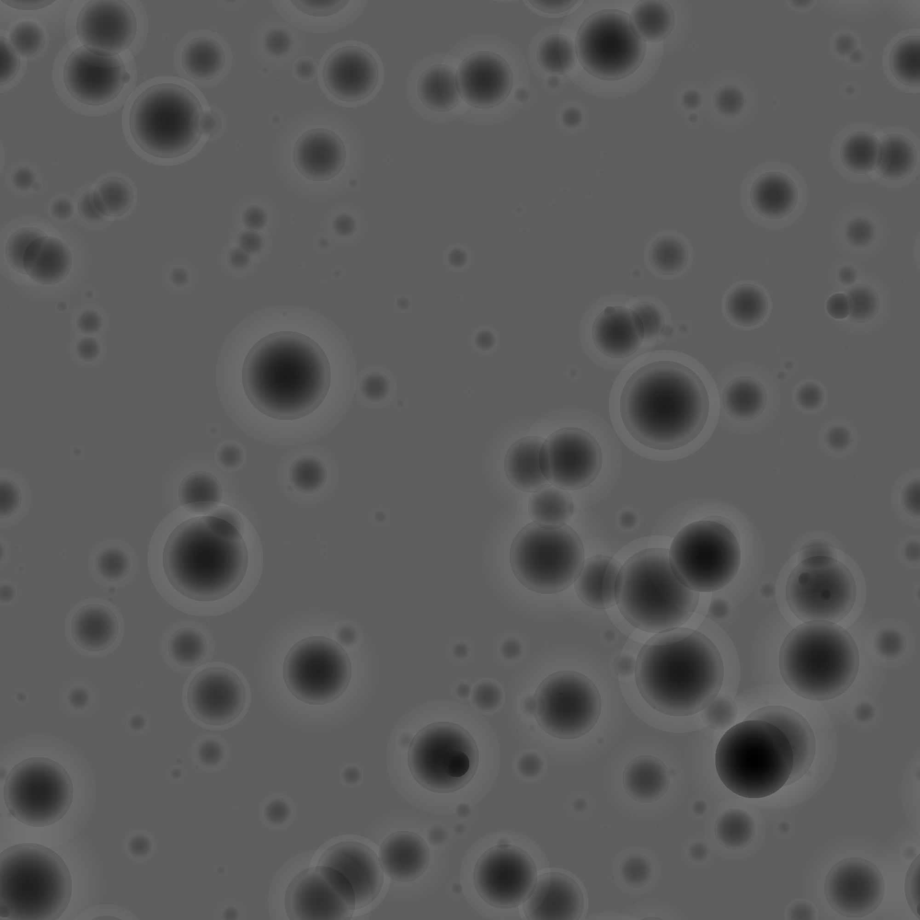
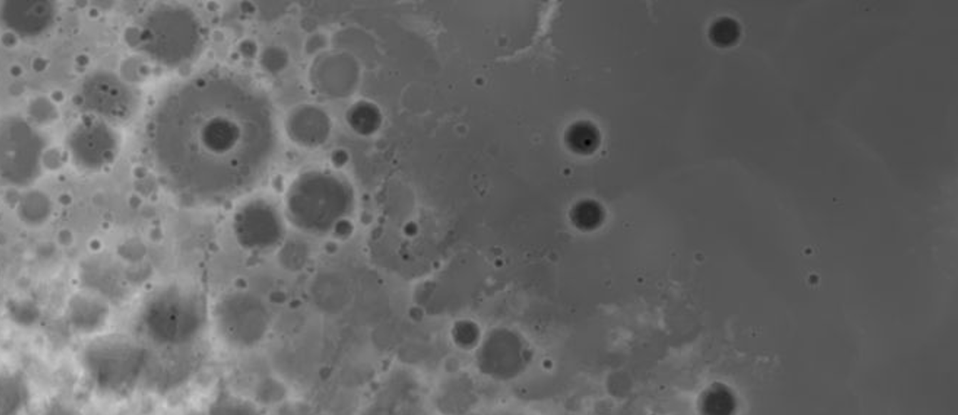
Implementation - Feature Generators
Mimic - Procedural Map Generator
Lunar Craters
Mimic Impact Generation
Close up

Slide 32
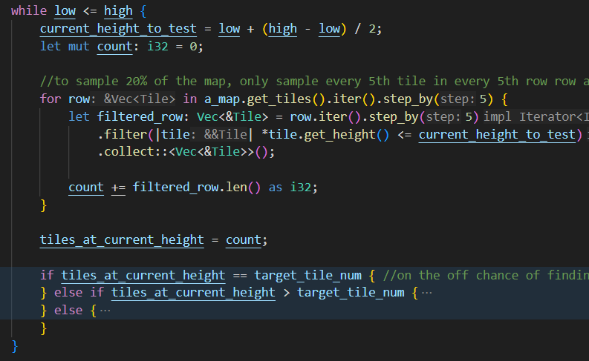
Water Map Generator
Implementation - Feature Generators
Mimic - Procedural Map Generator
Takes in a percent of water the map should be covered with
Multiplies it by the map’s area to get a target number of tiles to cover
Binary search’s the map’s height range for the height with the closest number of tiles at or below it
Only samples 20% of the map

Slide 33
Implementation
Mimic - Procedural Map Generator
Map Setup

Slide 34
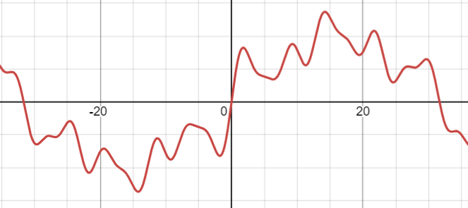
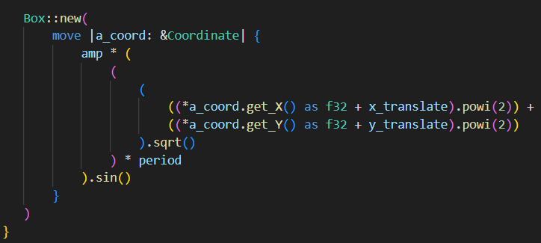
Making Noise
Implementation - Map Setup
Mimic - Procedural Map Generator
Create an arbitrary number of them and add them together
Each wave is made unique by changing their translations, amplitudes, and periods
Flawed - can be improved to be simpler and create more natural looking noise, since this way allows multiple sine waves with the same period to be combined

Slide 35
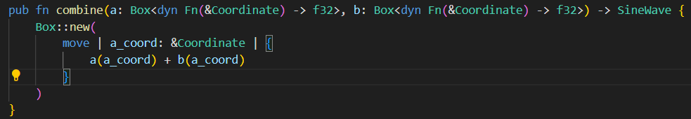
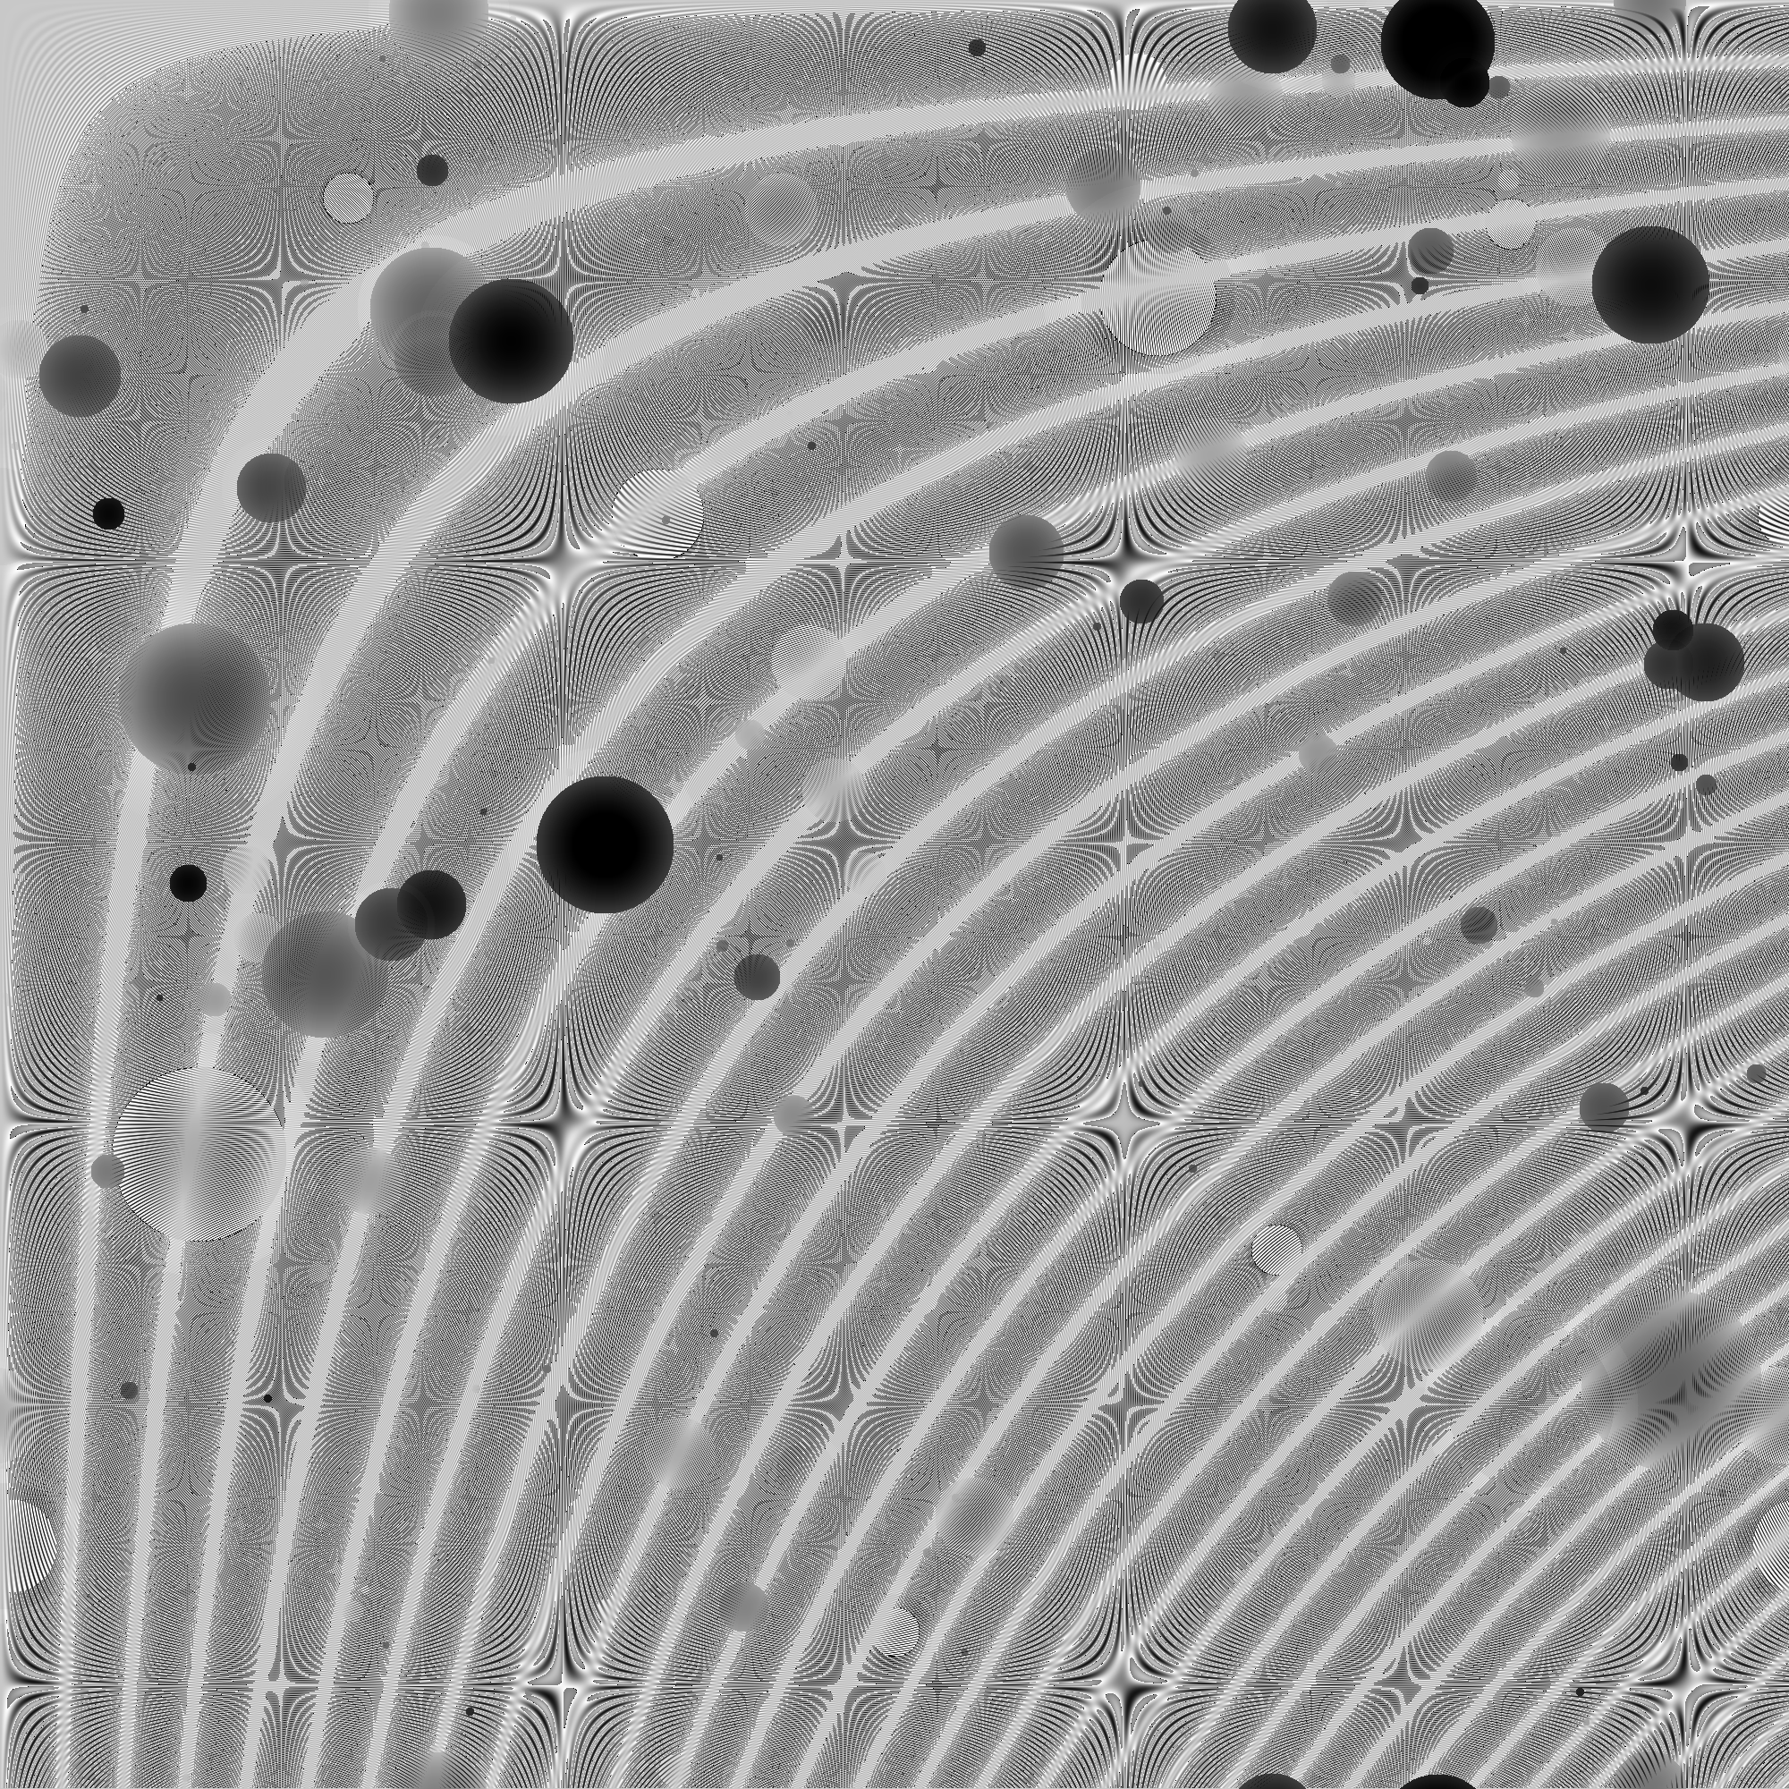
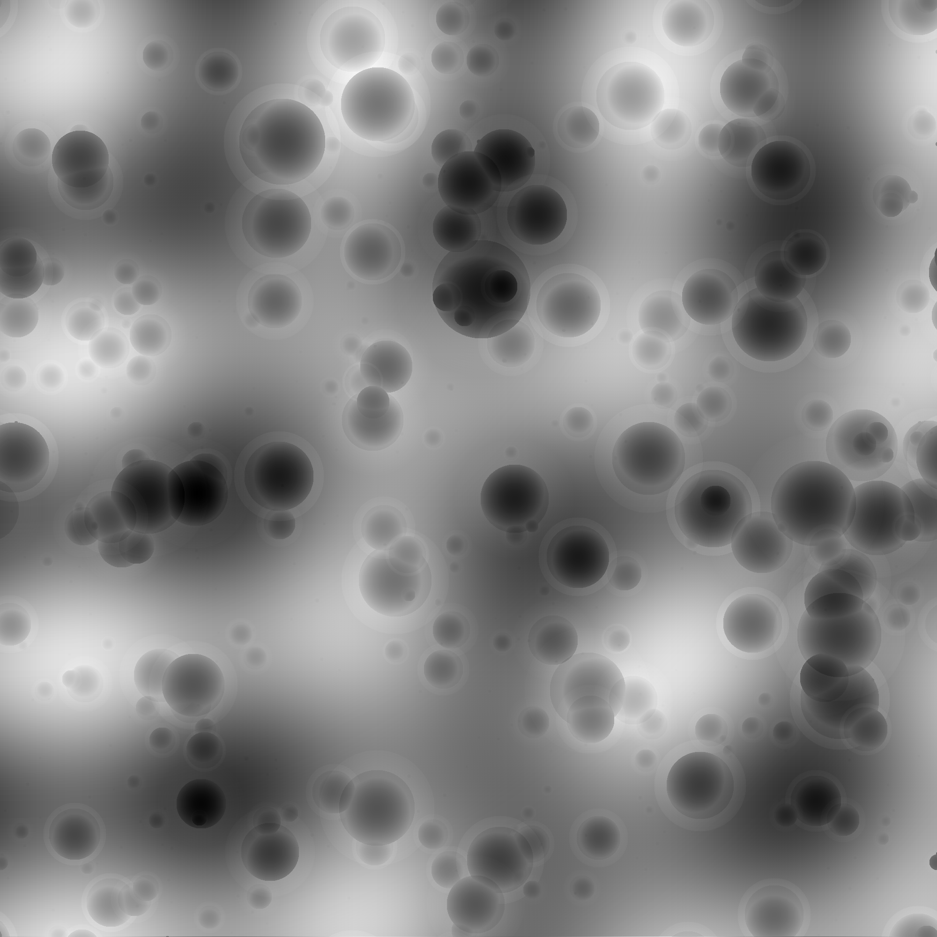
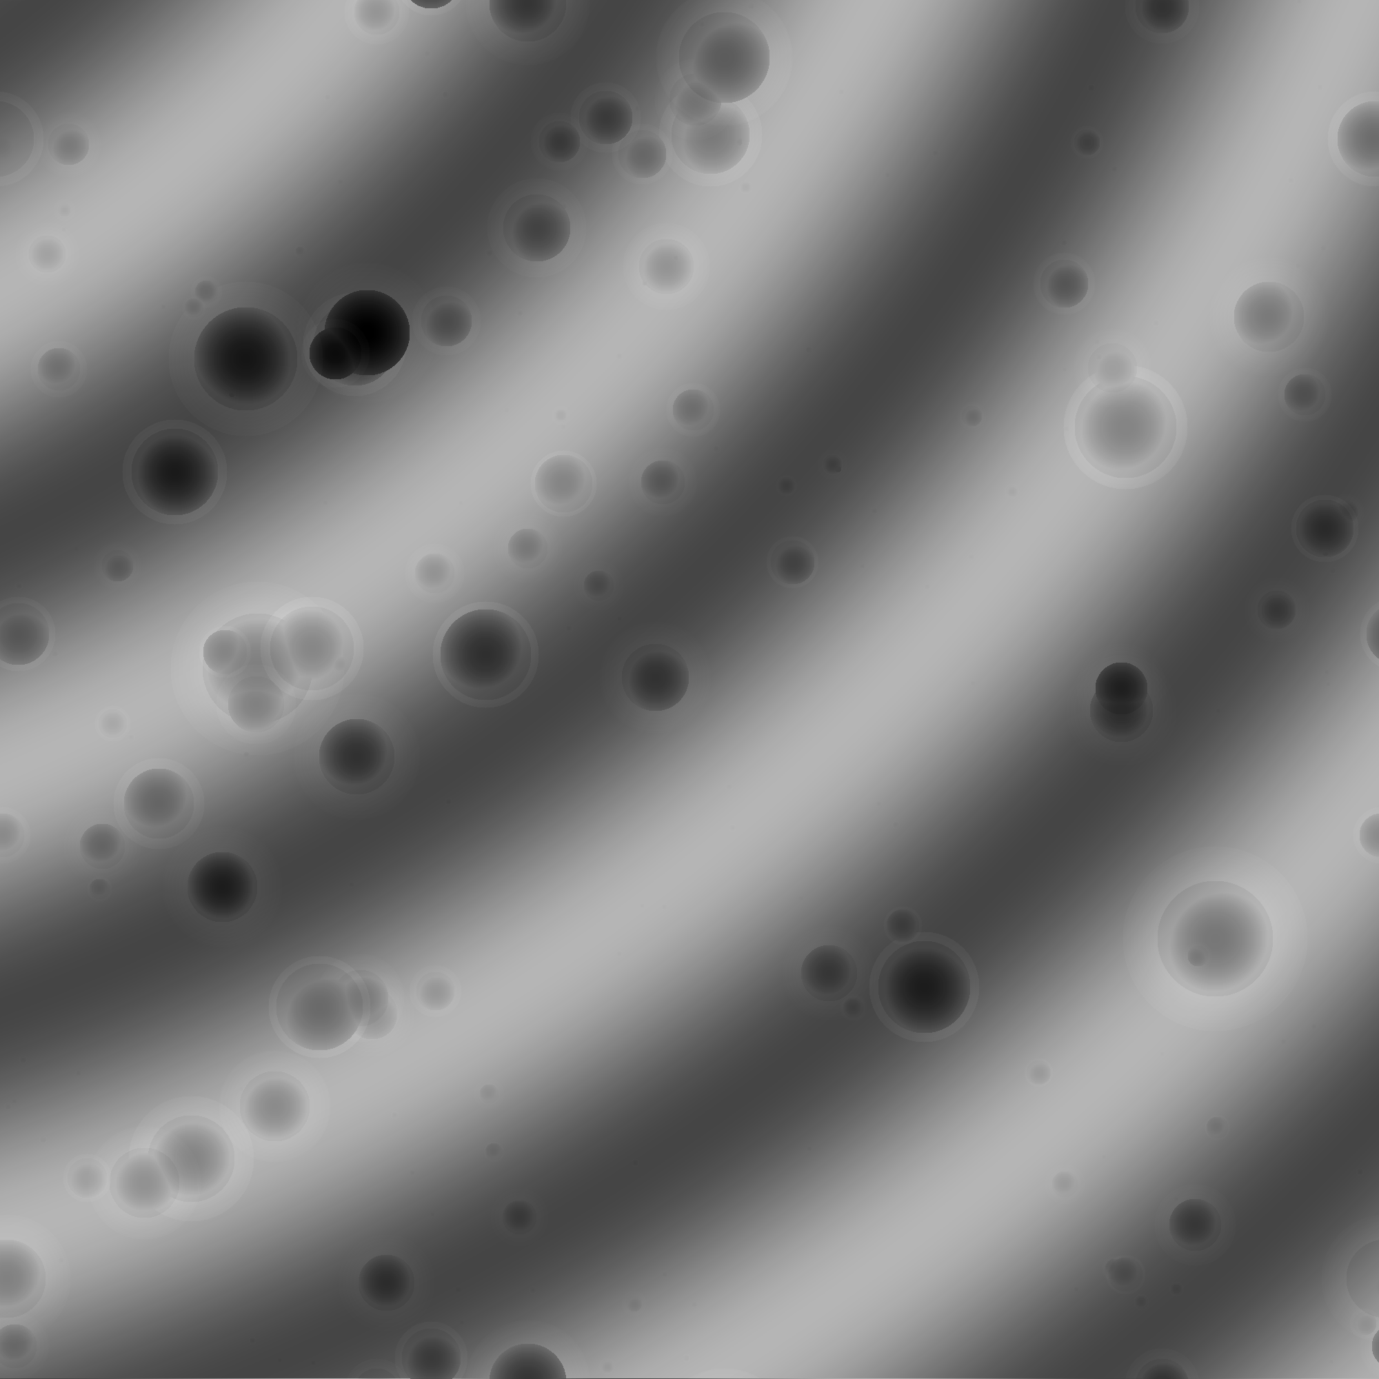
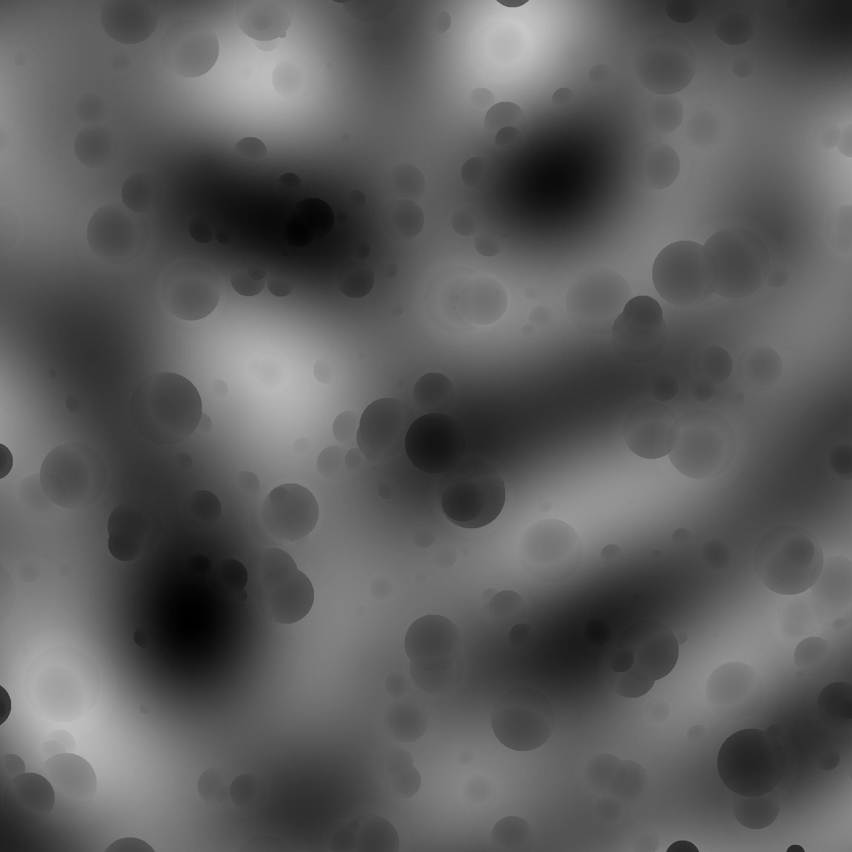
Combining Closures
Implementation - Map Setup
Mimic - Procedural Map Generator
Rust allows you to combine closures in virtually any way
Offers immense flexibility
Can allow for on the fly definitions of functions and behaviors at runtime, such as the creation of noise functions

Slide 36
Chapters
Mimic - Procedural Map Generator
1.
Introduction
2.
Analysis and Design
3.
Rust
4.
Implementation
5.
Reflections

Slide 37
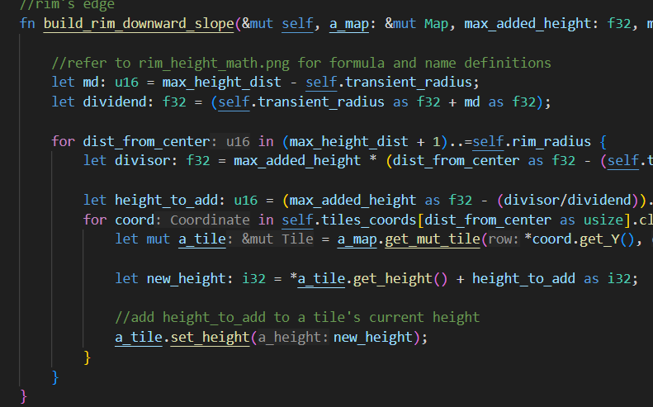
Learning Rust
Reflections
Mimic - Procedural Map Generator
Overengineering
Combined with time constraints, resulted in unnecessary code
Learned new things as they became necessary
Constant refactoring
Still many things if I’d like to refactor, now that I have a better understanding of the language
Hard to gauge code quality and ask for help

Slide 38
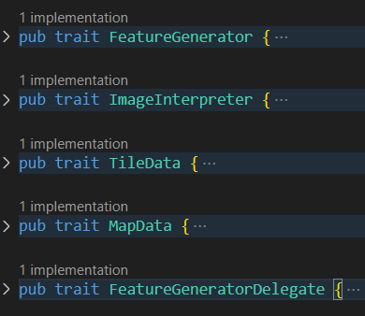
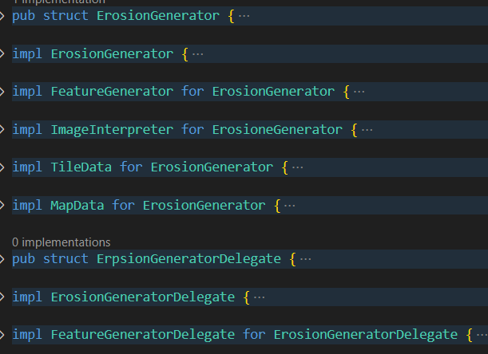
What’s next?
Reflections
Mimic - Procedural Map Generator
Refactor map generator, image interpreter, tile and map to use trait objects
Clean up type casting
Map specifications and specification parsing
More generators
Plate tectonics experimentation

Slide 39
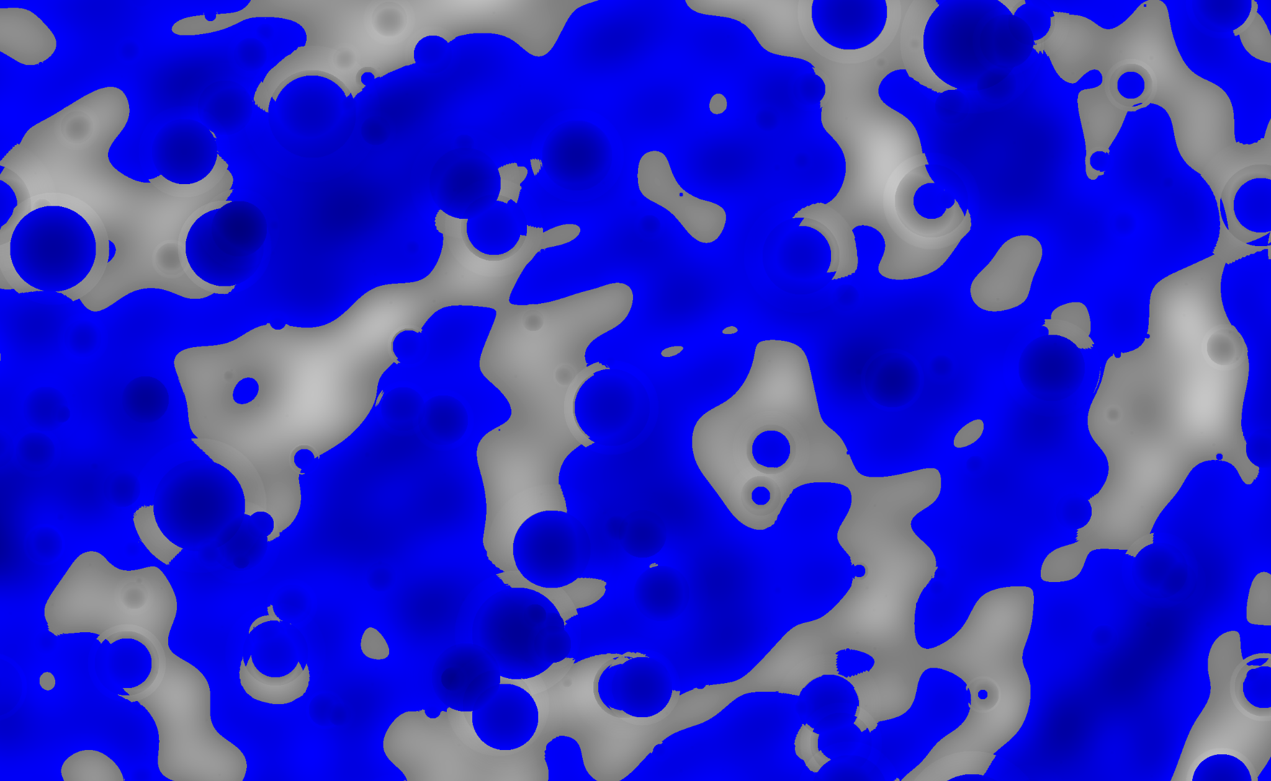
Thank you
12/11/24
Size: 104,529 bytes Lines of Code: 3105 Word Count: 10104
39

